Slide 1

Project 1- Data Analytics Turkey Earthquakes
Team 2

Slide 2


Collaborators
Cecilia Lizcano
Omar Alejandro Vallejo
Erica Alvarez
Roberto Rodas
Alvaro Corona

Slide 3


Turkey
Has an area of
785,350 km2
Population
85,279,553 people
Capital
Ankara
Currency
Turkish lira

Slide 4

Turkey Earthquake (Nurdağı )
According to the journal reports, a disastrous earthquake that struck early Monday morning in February 2023 in Turkey, left more than 12,000 people dead and more than 49,000 injured.

Slide 5

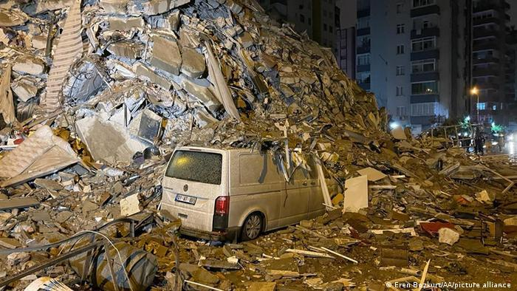
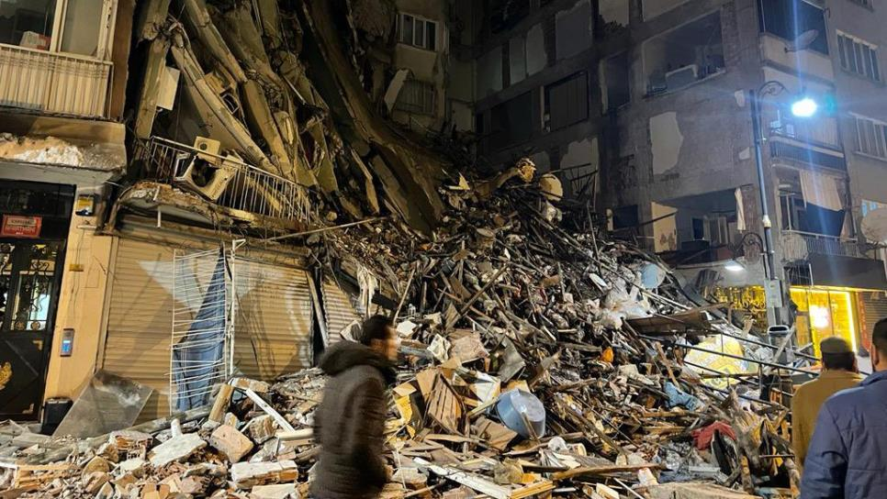
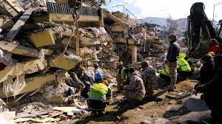
Impact of the Earthquake

Slide 6

Source:
United States Geological Survey
https://earthquake.usgs.gov/earthquakes/search/
The USGS monitors, analyzes, and predicts current and evolving Earth-system interactions and delivers actionable information at scales and timeframes relevant to decision makers.

Slide 7

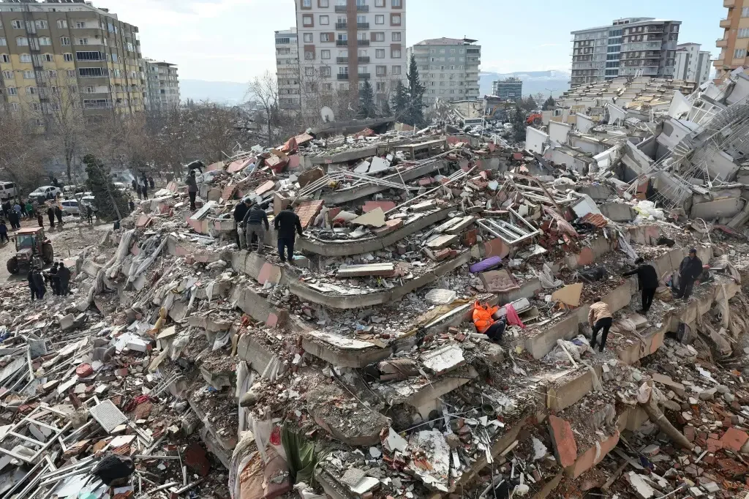
Questions about the Earthquake in Turkey
What was the date and time of the most disastrous earthquake recorded in Turkey according to the dataset?
During what period of time did the seismic activity increase in Turkey?
What was the magnitude of the most devastating earthquake in Turkey's history according to the dataset?
In which specific region of Turkey did the most destructive earthquake recorded in the dataset occur?
What was the depth of the epicenter of the most devastating earthquake recorded in Turkey, according to the dataset?
Which were the main cities or localities affected by the most catastrophic earthquake in Turkey according to the dataset?

Slide 8

Dataset description
Time | Mag | Lat & Lon | Depth | Id
Refers to the date and time that occurs the earthquake, we use data from july 2008 to july 2023 | The magnitude on richter scale. The values are filtered by earthquakes greater than 2.5 degrees | There are the coordinates of the earthquakes. We took a radius of 1,500 km from nurdağı | Is the profundity between the surface and the hypocenter of the earthquakes | It refers to the unique identification of the earthquake designated by USGS
Columns

Slide 9
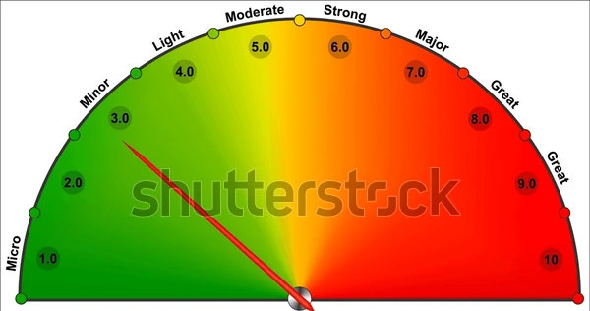
Scale Filter
The data was filter starting at moderate: Mag > 5

Slide 10
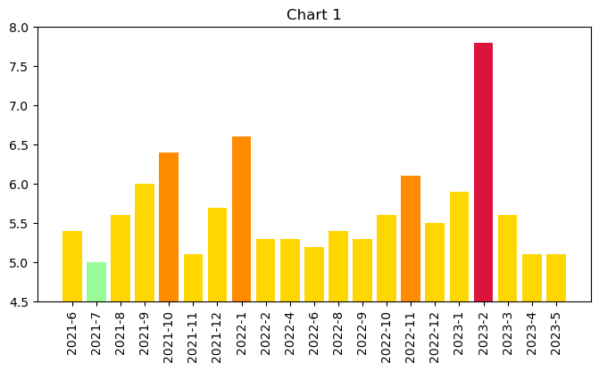
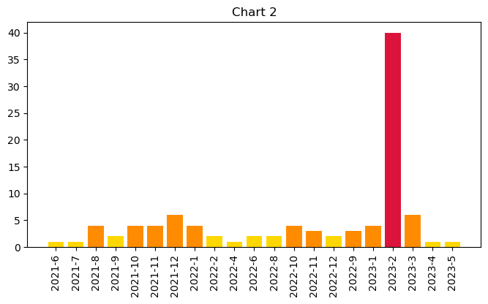

According to the dataset, what period of time did the seismic activity increase in Turkey and which were the main cities or localities affected ?
The greatest Earthquakes per month from june 2021 to june 2023. This values were filtered by greater than 5 on richter scale
Earthquake amount per month from june 2021 to june 2023. This values were filtered by greater that 5 on richter scale

Slide 11
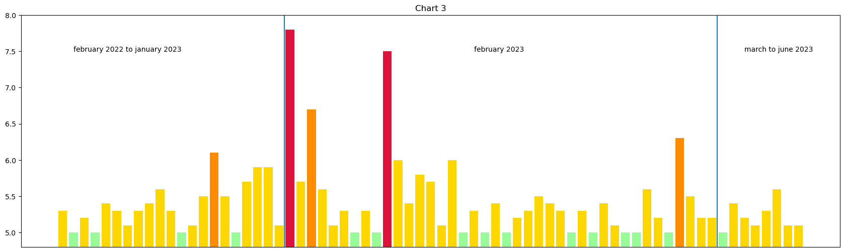
The Seismic activity of February 2023 contrasted with the activity
of a whole year and the rest of 2023
The Seismic activity of February 2023 contrasted with the activity of a whole year and the rest of 2023

Slide 12
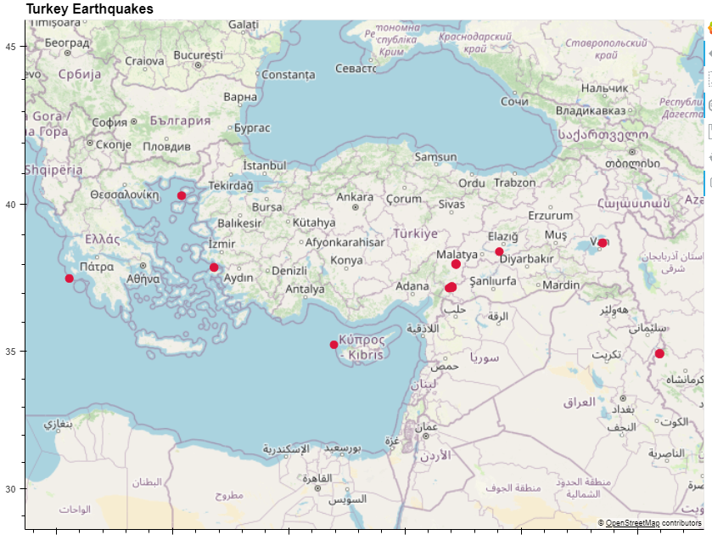
According to the dataset, what period of time did the seismic activity increase in Turkey and which were the main cities or localities affected ?
The main cities in turkey affected by the earthquakes were:
Nurdağı
Ekinözü
Khane Shur village
Tuşba
Sivrice

Slide 13

¡Speaker demonstration!

Slide 14
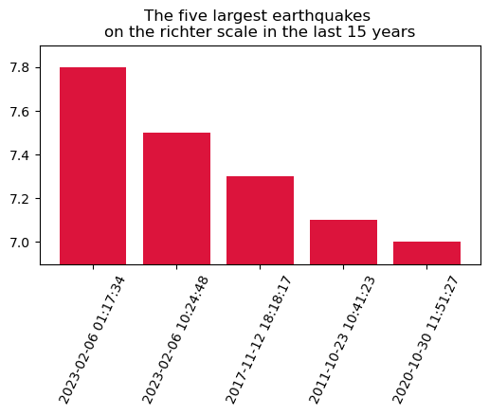
What was the date, time and which specific region of Turkey did the most disastrous earthquake recorded in Turkey according to the dataset?
The five greatest earthquakes on the richter scale registered in the last 15 years

Slide 15
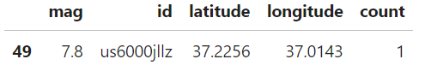
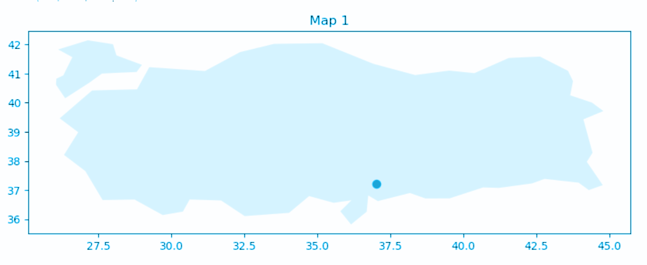
What was the date, time and which specific region of Turkey did the most disastrous earthquake recorded in Turkey according to the dataset?
According to the dataset, the region of Turkey with the most destructive earthquake was the province of Gaziantep

Slide 16
¡Speaker demonstration!

Slide 17
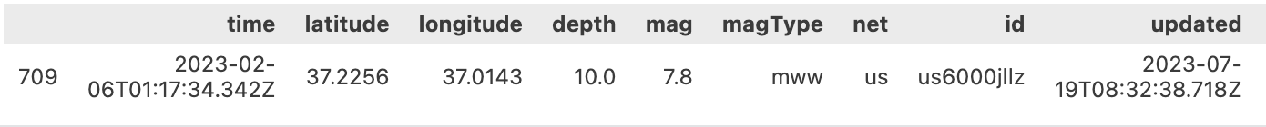

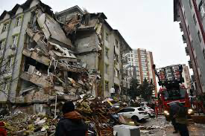
What was the magnitude of the most devastating earthquake in Turkey's history according to the dataset?
the strongest magnitude is 7.8 the day 2023-02-06T01:17:34.342Z at the depth of 10.0 ,which is considered the most powerful earthquake, that has occurred in the selected country in relation to the database

Slide 18
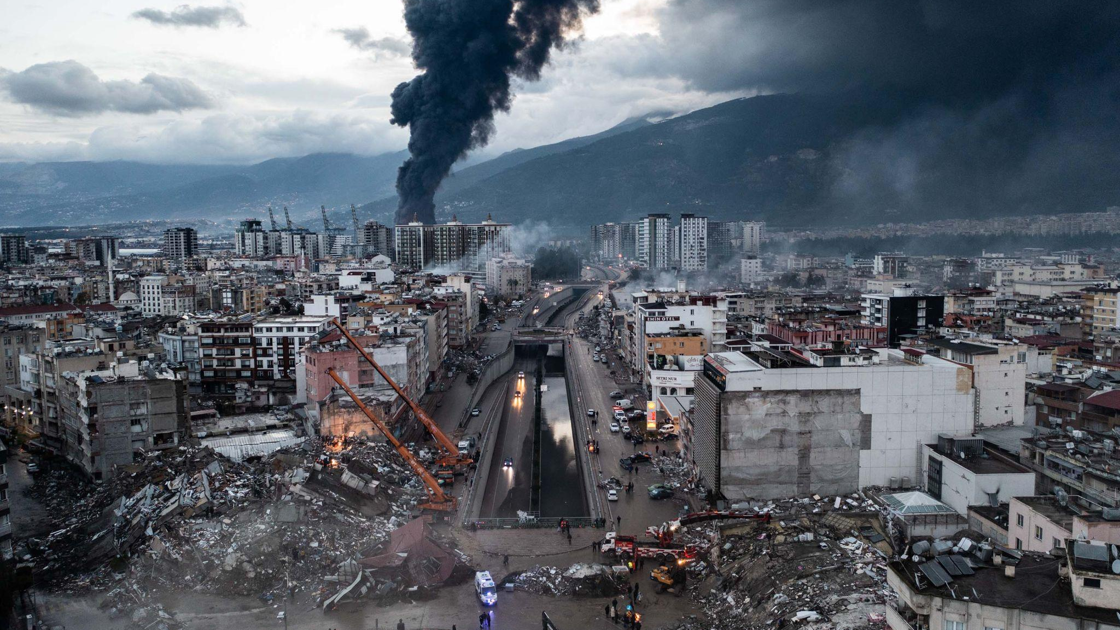
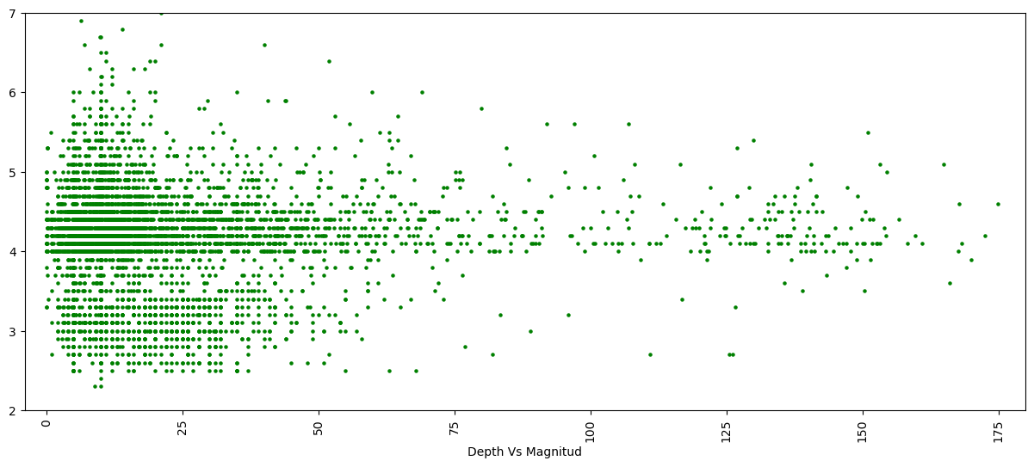
Was the magnitude of the most devastating earthquake recorded in Turkey related to the hypocenter depth?

Slide 19
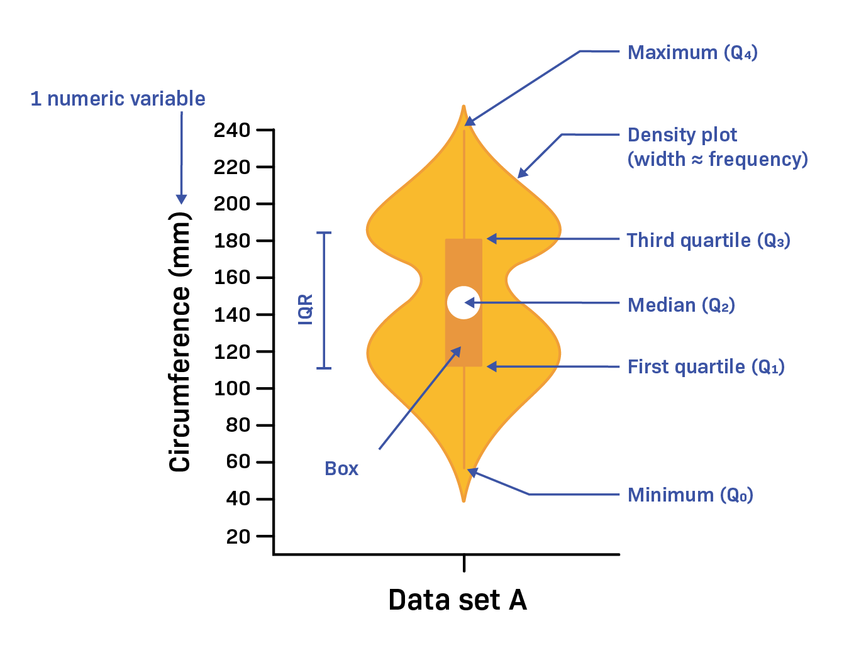

Violin Plot
¿What is?
How to read it?
It is a plot distribution of numeric data for one or more groups (an hybrid of a box plot and a kernel density).

Slide 20

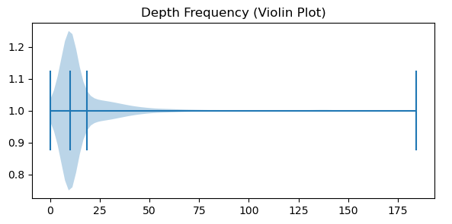
Was the magnitude of the most devastating earthquake recorded in Turkey related to the hypocenter depth?
MDE Depth: 10 km

Slide 21
¡Speaker demonstration!

Slide 22

CONCLUSIONS
The greatest Earthquakes per month from june 2021 to june 2023.
Two of the five greatest earthquakes on the richter scale registered in the last 15 years, occurred while february 2023.
The hypocenter depth of Turkey earthquakes didn’t have relation to their magnitude as the most devastating earthquake recorded depth was near to the median.

